Slide 1
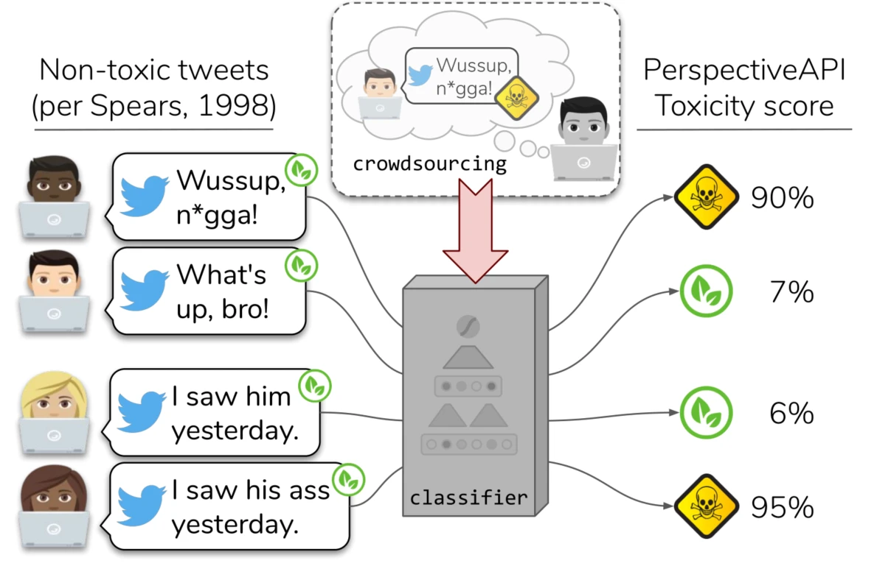
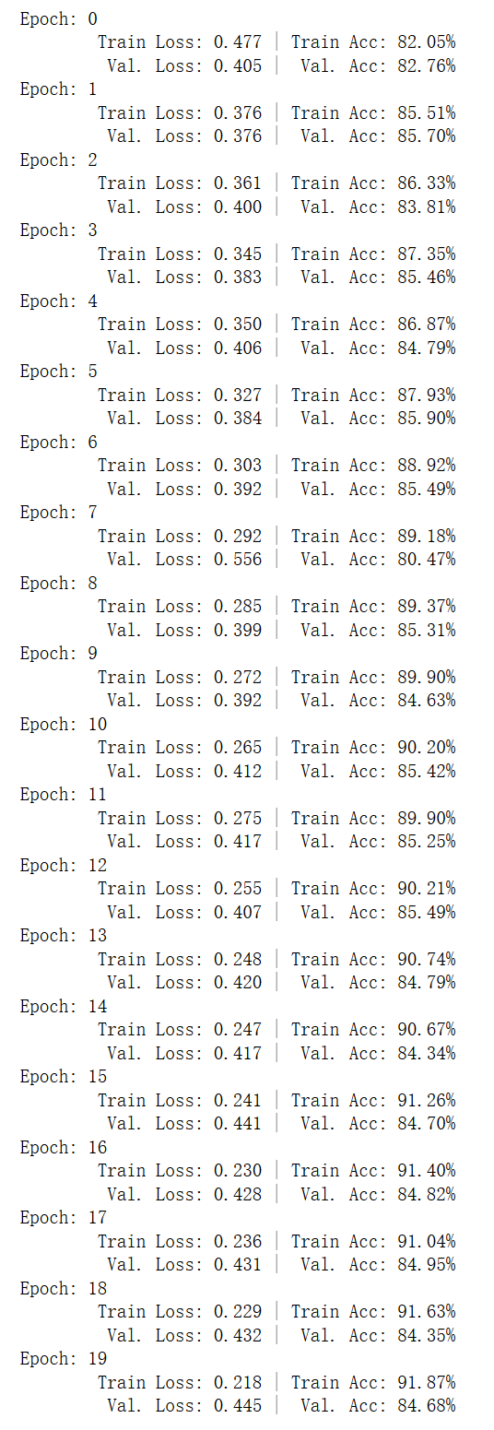
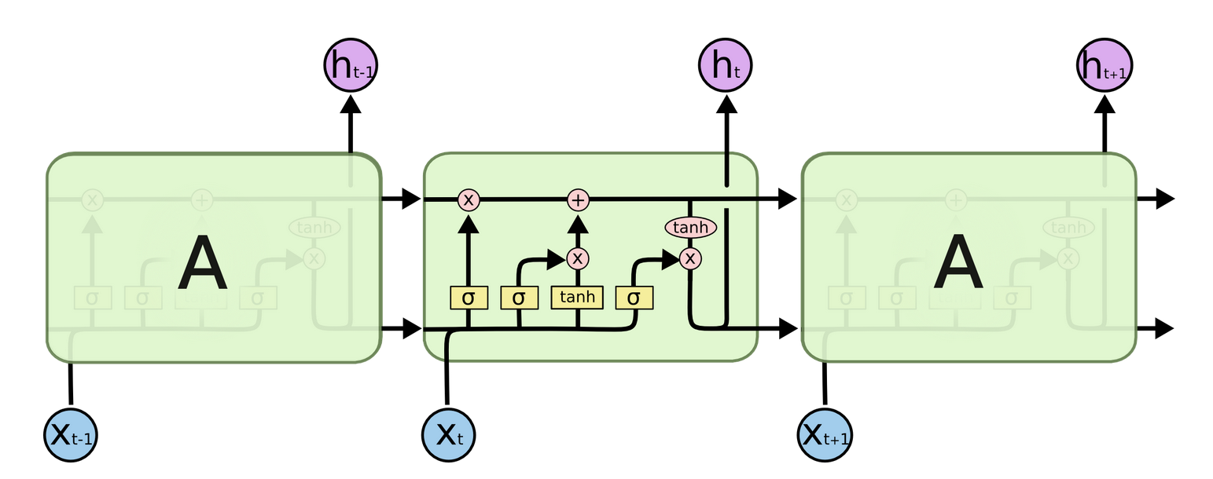


Automated Hate Speech Detection with LSTM Classifier
Team Project by Hu, Xiaoyan for the Course: Natural Language Processing with Deep Learning, Hertie School
Proposed Method
Results Analysis
Dataset:
25k tweets containing terms collected by Davidson et al. (2017) from the lexicon and had them manually coded by CrowdFlower (CF) workers.
Model:
Baseline: Multinomial Naive Bayer
Deep Learning: Long Short-Term Memory network (LSTM)
Implementation framework: PyTorch
[SIMPLE ILLUSTRATION OF THE LSTM MODEL FROM COLAH’S BLOG]
Results:
79.22% for baseline model;
84.68% for LSTM model on the validation dataset.
Successfully implemented the deep learning model
High probability of overfitting: From graph on the right-hand side, this project observes a high probability of over-fitting in this LSTM model. While the training loss steadily decreases from 0.361 to 0.218, the validation loss gradually increases from 0.3 to 0.445. At the same time, Training accuracy improved from 86.33% to 91.87% while the validation set accuracy stagnated around 84% through the whole course.
Potential cause: too small data size for LSTM model.
Research Motivation
Automated detection using a computer algorithm is one of the potential alternatives to human moderators against hate speech spread on social network. This project aimed at understanding the mechanism behind this automation by building a deep-learning detector with the dataset from the open web. Thus, it was duplication work fundamentally. It attempted to state-of-industry RNN approach for classification task on a Twitter dataset.
As a work of reproducibility, this project managed to adapt a simple LSTM model on a different dataset labelled by Davidson. The project achieved an accuracy rate of 84.68%, which is a state-of-the-art result. The implementation process provided the author with an opportunity to dive deeper into the theory behind text classification and the rationale behind automated hate speech detection.
Conclusion
Reflection
The implementation process provided the author with an opportunity to understand the theory behind text classification and the rationale behind automated hate speech detection.
Although this project adopted the LSTM model, the author is aware of the drawbacks of LSTM as it still cannot memorize sequences that scale beyond a certain range. Moreover, the RNN models are not hardware friendly which means that it takes many computation resources. Many improvement and alternatives have been proposed, especially those that centered around “attention”.
Apart from efficiency and accuracy, we still face other challenges:
Technical: distinguish subtle contextual differences, active detection evasion etc.
Non-Technical: right balance between freedom of speech and hate speech quarantine, what do our values stand for facing hate speech.
Notes:
Hi, this is Adele
Thanks for listening to my project presentation for the course Python Programming for Data Scientists at Hertie School
Public policies are often out of mixed motivation. If we don't want to read hundreds of press release, meeting notes and speeches on our own, how can we know what's in the mind of policymakers?
This project aims at exploring an alternative with the case study "on Political motivation behind French government's endorsement for the electric vehicle industry". I divide my project implementation into three parts:
Crawl all relevant documents from the French government website using the scrapy library
discover the hidden relations between terms and topics by constructing a latent dirichlet allocation topic modeling with gensim library
Visualize the findings with pyLDAvis package, showing the proportion of each topic in the corpus and their relative distance
On the right hand side of the poster, you can see a screen shot of the interactive graph generated with pyLDAvis package.
This project finds that there is a high concentration of industry related terms in topic one, shown as the biggest red circle. It implies that government eagerness to plan an industrial upgrade probably outweighs ecological concerns. Environment related terms are more widely and equally associated with high ranking topics. Thus, it is maybe a more prevalant theme for the French government.
Both Scrapy and LDA are easily scalable and can be adapted to future research of a similar nature with a much bigger corpus.
I am looking forward to your feedbacks, thanks for listening

